Slide 1

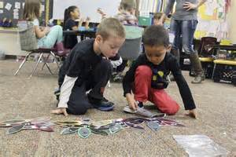
Tier III Complex Needs

Slide 2
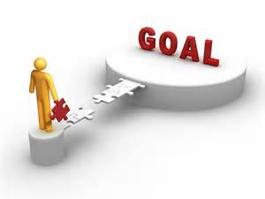
Learning Intentions
Review of Trauma & Brain Development
Self-Regulation – 5 Domains

Slide 3
Trauma & Brain (childtrauma.org)
Neuroplasticity can work in two directions: It is responsible for deleting old connections as frequently as it enables the creation of new ones.
Overactive limbic system – growth from front to back—first 3 years critical
Trauma operates from state of arousal/alarm and fear not rationale – ill-prepared to learn/be social—living in the minute
Some use a hyperarousal response (e.g.,fight or flight) and some a dissociative response (essentially “tuning out” the impending threat)

Slide 4
BIOLOGICAL DOMAIN
Developmental delays as children
Frequent medical issues
Increased stress hormones (cortisol)
Increased glucose
> amygdala and < hippocampus
Impaired sleep

Slide 5
COGNITIVE DOMAIN
Limited problem solving
Problems processing new information
Problems focusing and completing tasks
Difficulty planning and anticipating
Problems with orientation in time and space
Impaired memory short term and for significant life events
Dissociation

Slide 6
EMOTIONAL DOMAIN
Problems with boundaries
Attachment challenges
Distrust, suspiciousness
Social isolation
Interpersonal difficulties
Difficulty assessing others’ emotions

Slide 7
SOCIAL DOMAIN
Fear of new situations
Isolation
Lack of sense of self
Low self-esteem
High degree of shame and guilt
Poor ability to separate even from dysfunctional relationship

Slide 8
SOCIAL DOMAIN
Poor impulse control
Self destructive behaviour
Aggression towards others
Substance abuse
Oppositional behaviours or excessive compliance
Difficulty assessing others’ emotions

Slide 9
PROSOCIAL DOMAIN
Egocentric vs Empathic
Absorbed in their own internal state
React vs Respond

Slide 10
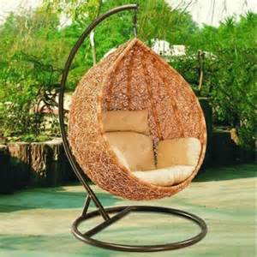
*Relational, Rhythmic & Repetitive
Relationship must be nurturing and safe
Rhythmic: song, toss ball, swing, drum – can mimic heartbeat and soothing
Repetitive structure and routine
Use of indirect object
If you can name it you can tame it
Use it won’t lose it

Slide 11
*Not an Easy Task
What do we see?
            Move to Fear (triggered more often)
            Bids for attention and Reactive attachment
The more a child trusts you the more s/he will turn to you to help deal with stress. You might encounter resistance, frustration, obstinence, and all too often, sheer incomprehension as you try to get a child to understand that s/he is hyperaroused, let alone what s/he might do to calm down.

Slide 12
*Self-Regulation and Traumatized Child
Change child’s trajectory from relying on primitive neurobiological mechanisms for dealing with stress (e.g., fight-or-flight or freeze) to turning to others for help and to calm (social engagement)
Constant tension and high energy in body or no energy (cortisol levels), hyper-vigilant and easily triggered, hoarding, needs to be alone to sooth
Can't force but must guide energy
  In order to regulate we need to change intensity of stimuli (environment or adult)
  We want them to invite us into their existence

Slide 13
Limbic Spewing
Constantly seeking out experiences that will trigger the release of adrenaline
Adrenaline feels good/exciting so difficult to go straight to breathing
Explain impact of adrenaline =worn out and cranky
Give choice for down regulation and may need special routine
eg. nice place to be when less busy, being with someone, cuddly sensations e.g. blanket: what really works about this calming place?

Slide 14
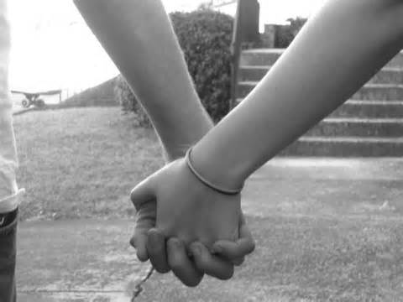
Need Co-Regulator
Leader, joy, routines and relationships
To develop dimmer switch (flooded to hyperalert)
Questions:
I see... what do you need to re-engage?
How do you think you could...?
What happens to other students?
What does your body need?
Determine what is working (situations, routines, times of day)?
Reflect back-- what feels good? Eg more energy, more listening, water, food..; Is it better?

Slide 15
Self – Regulation Critical Elements
Know what calm and alert is
Recognize when stressed
Identify what is stressing you
Take action with a strategy
Everyone has different baselines of arousal & affected by different stressors and stimuli
Different levels of energy are expended to engage in a similar activity
Energy expended depletes our resources (affects the attention span and ability to keep up with lesson) - may lead to anger, withdrawal and/or anxiety

Slide 16

Domains Tools
Biological
Teach breathing and how to be calm and then teach triggers
Breathing
  Teach how to breathe with stomach
  Blowing bubbles, cotton ball
  Smell the rose, blow out the candle
  Your favourite flower is a rose; to smell it you breathe through your nose, keep it in as long as you can go, then let it out in one big blow
  Handout from yesnet.yk.ca - make it a routine

Slide 17

Biological cont’d
Energy cycle (up and down-regulate, sensory circuit)
How do I down-regulate as breathing may not be possible?
Self-sooth (quiet box, rocking, repetition)
Hydration and food routine-sufficient energy across day
Slow starts (read, craft, mandala, nature walk, yoga)
Visual and auditory stimulation: noise-cancelling headphones/music or cubby holes
Explicit teaching of tools e.g bike

Slide 18
Sensory Circuit
Deep Pressure/Proprioceptive feedback, where body is in space; core muscle strengthening and balance and quiet brain to focus on body
Not whole class-too much stimulation
Tailor for each

Slide 19
Sample Schedule
Check-in (zones of regulation and body sheet)
Warm-up (e.g. laps doing animal walks or with weighted object)
Cycle through 3-5 stations (e.g. Scooter board, Ball, Trampoline, Theraband, Physical Conditioning), 2-3 minutes each
Cool down (yoga positions, breathing)
Wrap-up discussion, check-in (zones of self-regulation), prepare student for return to class

Slide 20
Daily Practice Whole class
Language
Up-regulation
Down-regulation
Self-control games
Simon Says
Green light, red light
Freeze tag
Martial arts
Following directions, patterns, recipes
Tone of voice
Volumne
Pace
Rhythm
Words we use
Peaceful music/drawing
Yoga/sandtray/playdoh
Bean-bag/Rocking chair
Breathing
Reading
Dimmed lights
Movement Breaks
Exercise/boot camp
Brain Gym
Stimulation
Oral stimulation and hydration stations

Slide 21
Explicit Teaching
Teach, Do, Check
Ask how to use bike safely – sufficient tension, slow pedal, one person on bike
Ask students how not to use
Student models
Debrief how model did
All children try

Slide 22

Emotional Domain
Evaluate, and modify the intensity of one's response; and when and how to express emotions
Zones lesson
Reset tools
Body language
Temperature Gauge and Big Problem/Little Problem – and anger release strategies
Bibliotherapy (Howard Wigglebottom, Seeing Red, Huebner: what to do when you grumble/worry too much, Happy panda, I am a rainbow, odinbooks.com)
Mindfulness (thinking vs emotional brain)
Moods pass
ACT
Anger Release

Slide 23

Cognitive
Routines
NWT profile
Cognitve/attentionalcontrol activities
Alternative seating
Metacognitive strategies/checklists, organizational techniques
Advance notification
Task Appropriateness: Match energy level to the demands of a task or situation
Understand the brain parts

Slide 24
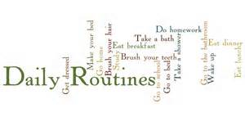
Routines
Every demand on ourselves from deciding what to eat to managing frustration, from building an exercise regiment to persisting at difficult tasks-- all draw on the same small easily depleted reservoir of energy --the sustaining power of rituals comes from the fact that they conserve energy and provide a stable framework in which creative breakthroughs and renewal often occur.

Slide 25
*Routines/Behaviour Management
Proactive—anticipate triggers/plan for misbehaviours
Schedule: Consistency/Predictability = safety
  Premack principle
  Book end the day: Check-in (slow start, greeting, zone, go over schedule, breathe) and check-out (zone, reflection and gratitude)
  Up/down regulation and sensory room/self-soothe activities/self control
Social brain: Paired activities, singular and class activities
Visuals and explicitly teach any problem area or hotspot (PBIS)

Slide 26
Visuals
Visual learners and worth a 1000 words
Help organize, structure, and reduce anxiety for students
To increase success, self-confidence and independence, by reducing the reliance on verbal prompts and redirection

Slide 27
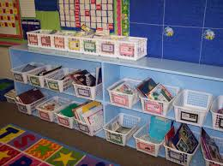
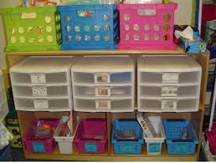
Structure environment

Slide 29



Use visuals to structure the day
Use a daily visual schedule to outline the day’s major activities.
Teach alternate symbols to indicate possible changes (ie. Surprise card, a cancellation)
Break lengthier time blocks into shorter, more specific segments
Use a visual timer to assist with time management throughout the day.
  Note: some students become anxious or overly focused on the timer itself.

Slide 31
As needed, walk around the school (5 minute breaks)
As needed, allow snacks depending on appetite
Take pictures of each place and list expectations (activity)

Slide 32
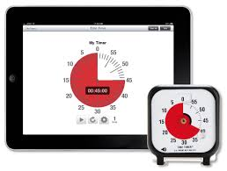
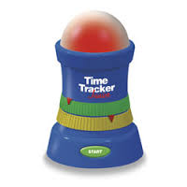

Slide 33
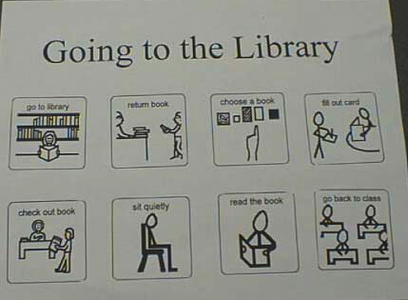
Use visuals to structure or sequence an activity
Break activities down into small, sequenced steps to:
  Increase independence for students who rely on external supports to sequence activities as well as to stay on task and

Slide 34
Use visuals to promote positive behavior
Use visual supports to:
Provide choices
Provide more frequent break opportunities
Reinforce and reward positive choices (ie. Token reward system, FIRST… (less preferred)… THEN (preferred activity)
Assist in self-regulation (Resources: Zones of Regulation, How Big is This Problem)
Support students with transitions

Slide 35
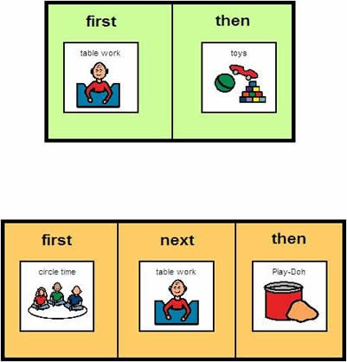
Use visuals to promote positive behavior
Notes:
Insert First Then with choices

Slide 36
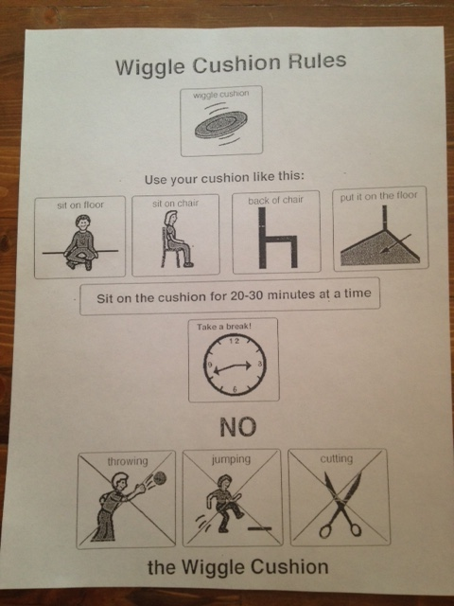
Notes:
Better photos!

Slide 37
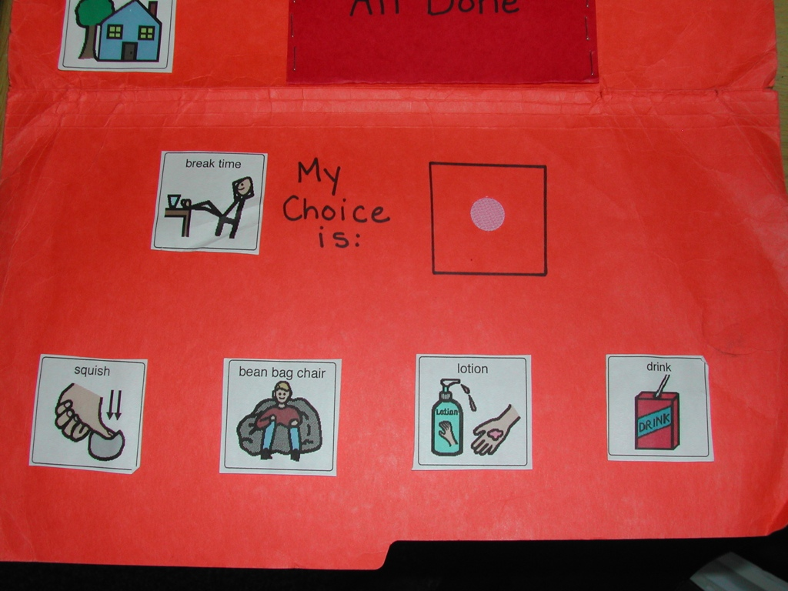

Slide 38
Notes:
Take better picture of behaviour consequence map, and cut out so just desk strip

Slide 39
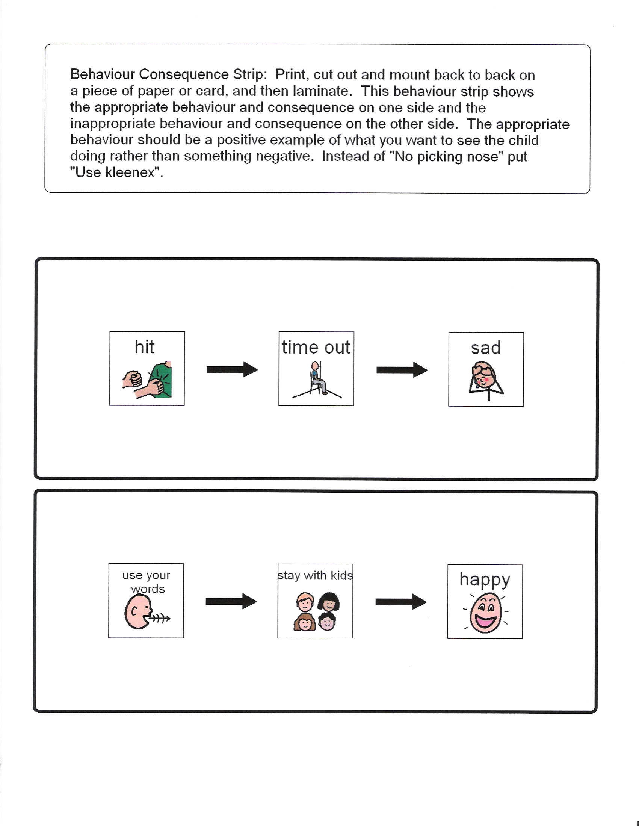

Slide 40
Use visuals to assist students to communicate
Use visuals to help students who have difficulty initiating conversation or asking questions (e.g. asking for help) to do so in a less threatening manner...this will also help teach them how to communicate in these ways

Slide 41
Routines/Behaviour Management
Language: Language acquisition and reflective thinking impacted if no co-regulation from nurturing interaction
  Reduce Transitions/Redirection/Freeze
  Emotions=mindful brain/unmindful brain
  Body (H/O)
Visual schedule of rewards (praise for small steps)
Use of timers – beat the timer- compliance and transitions (stop at door, sit and draw-mini slow start)
Explicit teaching eg bike, fidget tool
3 parts of play

Slide 42
Routines/Behaviour Management
Repetition
Demonstrating more positives than correctives –
More "dos" than "don'ts”
Applaud/Reinforce any incremental improvement
Offer Choice
Time for social brain and movement
Bridging/restitution
Do-overs-not letting one thing go by

Slide 43
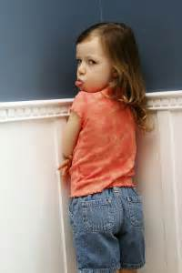
Misbehaviour
Overt noncompliance—avoid, redirect, provide choice and time for child to think and reflect, repeat rule and choice, quietly mention want child to be part of community, if noncompliance continues, then quiet direction to meet outside
Connector language•--let's think how we can solve; I need you to do such and such—what do you need vs what are you doing
Use your words, you know better (elicits connection), I'll wait until ready

Slide 44
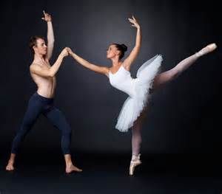
Social/Relationship
Co-regulation dance (in-sync)- adjust behaviour and regulation based on feedback
Morning Check-in and check-out
  Salutation, temperature gauge, breathe, compliment, routine for day
Sensory level includes rhythmic movement (dance, ball, singing, motor)
Cooperative skills – sharing, helping, include others, take turns, personal space

Slide 45
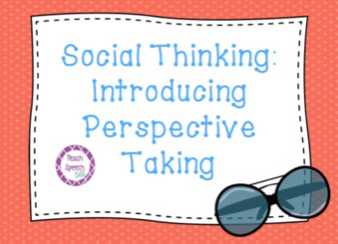
Perspective Taking
Social Cognition-reading social context
Perspective-taking: Accurately reading intentions of other and Anticipating consequences/impact on others and adjut
Understand that others have thoughts, feelings and experiences different from yours
Take others feelings into account
Are you being mindful? What is my/their brain thinking?

Slide 46
Social Thinking Language
Where should you be? You should be showing me what you should be doing;
Look at what everyone else is doing
Jon is doing a good job
What is expected in this situation; What is the group plan?
Is that expected?
What are other’s brain’s thinking?

Slide 47
Individual
I see... what do you need to re-engage?
How do you think you could...?
What happens to other students?
What does your body need?
Determine what is working (situations, routines, times of day)?

Slide 48
Social/Relationship Time
What do you get joyful engagement from?
  Nature opportunities, Sports, cooking, singing, creating (crafts)
Rocking time/cuddling?
Indirect objects
Phone home for something good and toodles
How am I incorporating both the social and motoric brain?
Social routines-salutations

Slide 49

Prosocial Domain
Empathy
  Causes stress-have to take care of self to give to others)
  Something more fragile and/or community engagement piece (elders, community garden)
Contribution activity – helping
Kindness-Bucket Fillers, include others
Gratitude journal

Slide 50

EXIT SLIP and thank you!
Turn to a partner & discuss which practice you will try
Make a deal - what do you feel comfy taking back and check-in two week

Slide 51
THANK-YOU

Slide 52
Educator Wellness Survey
We are the model as we teach who we are
It is allowing for authenticity in ourselves so we can reach out to others
Children do the best they can (E. Olsson)
Bids for attention (M. Brokenleg)
Belief about the significance of our role in their lives
Kids learn from people they like (Rita Pierson

